Slide 1
Midterm 2 review

Slide 2
What does the following Scheme function do?
(define (x lis)
(cond
((null? lis) 0)
((not (list? (car lis)))
(cond
((eq? (car lis) #f) (x (cdr lis)))
(else (+ 1 (x (cdr lis))))))
(else (+ (x (car lis)) (x (cdr lis))))
x returns the number of non-#f atoms in the given list.

Slide 3
Write a Scheme function that returns the union of two simple list parameters that represent sets.
(DEFINE (union set1 set2)
(COND
((NULL? set1) set2)
((MEMBER (CAR set1) set2) (union (CDR set1) set2))
(ELSE
(CONS (CAR set1) (union (CDR set1) set2))
)
)
)

Slide 4
Write a Scheme function that takes a list and an atom as parameters and returns a list identical to its parameter list except with all top-level instances of the given atom deleted.
(DEFINE (deleteall atm lst)
(COND
((NULL? lst) '())
((EQ? atm (CAR lst))
(deleteall atm (CDR lst)))
(ELSE
(CONS (CAR lst) (deleteall atm (CDR lst))))
)
)

Slide 5
Write a Scheme function that takes a list and an atom as parameters and returns a list identical to its parameter list except with all all-level instances of the given atom deleted.
(DEFINE (deleteall atm lst)
(COND
((NULL? lst) '())
((NOT (LIST? (CAR lst)))
(COND
((EQ? atm (CAR lst)) (deleteall atm (CDR lst)))
(ELSE (CONS (CAR lst) (deleteall atm (CDR lst))))
))
(ELSE (CONS (deleteall atm (CAR lst))
(deleteall atm (CDR lst))))
))

Slide 6
Write a Scheme function called funcQ2 which is an extension of the map function in Scheme. Basically, this new function will take three parameters: first parameter is the list of operations, the second and third parameters are lists of numbers. It will apply each operator to each of the corresponding elements of the lists.
>(funcQ2 '(> <) '(1 2 3 4) '(2 3 4 5))
=> ((#f #f #f #f) (#t #t #t #t))
>(funcQ2 '(> < -) '(1 2 3 4) '(2 3 4 5))
=> ((#f #f #f #f) (#t #t #t #t) (-1 -1 -1 -1))
>(funcQ2 '(+ - * /) '(3 4) '(1 5))
=> ((4 9) (2 -1) (3 20) (3 0.8))
>(funcQ2 '() '(3 4) '(1 5))
=> ()
(define (funcQ2 oplist list1 list2)
(cond
((null? oplist) '())
((null? list1) '())
((null? list2) '())
(else
(cons (map (eval (car oplist)) list1 list2) (funcQ2 (cdr oplist) list1 list2))
))
)

Slide 7
In the following Scheme code, the aim is the construct the list (2 4 6 ... 2N) recursively for an input N. For example, for N=5, the output should be (2 4 6 8 10). Please fill in the blanks to complete the code.
(define (Sequence N)
(if (= N 1) _______’(2)_________________
(__append__________________________ (Sequence (- N 1))
(list (_* 2 N_________________________)))))

Slide 8
1- Consider the following program writen in C syntax:
void swap(int a, int b){
int temp;
temp = a;
a = b;
b = temp;
}
void main() {
int value = 1, list[5] = {2, 4, 6, 8, 10};
swap(value, list[0]);
swap(list[0], list [1]);
swap(value, list[value]);
}
For each of the following parameter-passing methods, what are all of the values of the variables value and list after each of the three calls to swap ?
a. Passed by Value
value =1 , list = {2,4,6,8,10}
b. Passed by reference
value =6, list ={4,1,2,8,10}
c. Passed by value-result
value =6, list ={4,1,2,8,10}

Slide 9
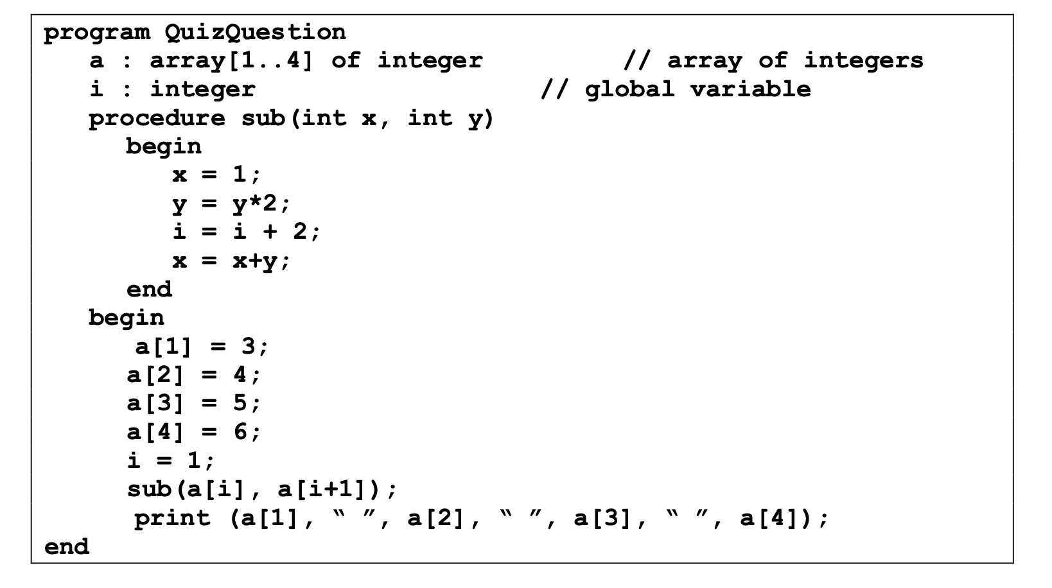
Pass-by-value
3 4 5 6

Slide 10
Pass-by-value-result (address is taken during return time)
3 4 9 8
if address is taken during call time
9 8 5 6

Slide 11
Pass-by-reference
9 8 5 6

Slide 12
Pass-by-name
1 8 11 6

Slide 13
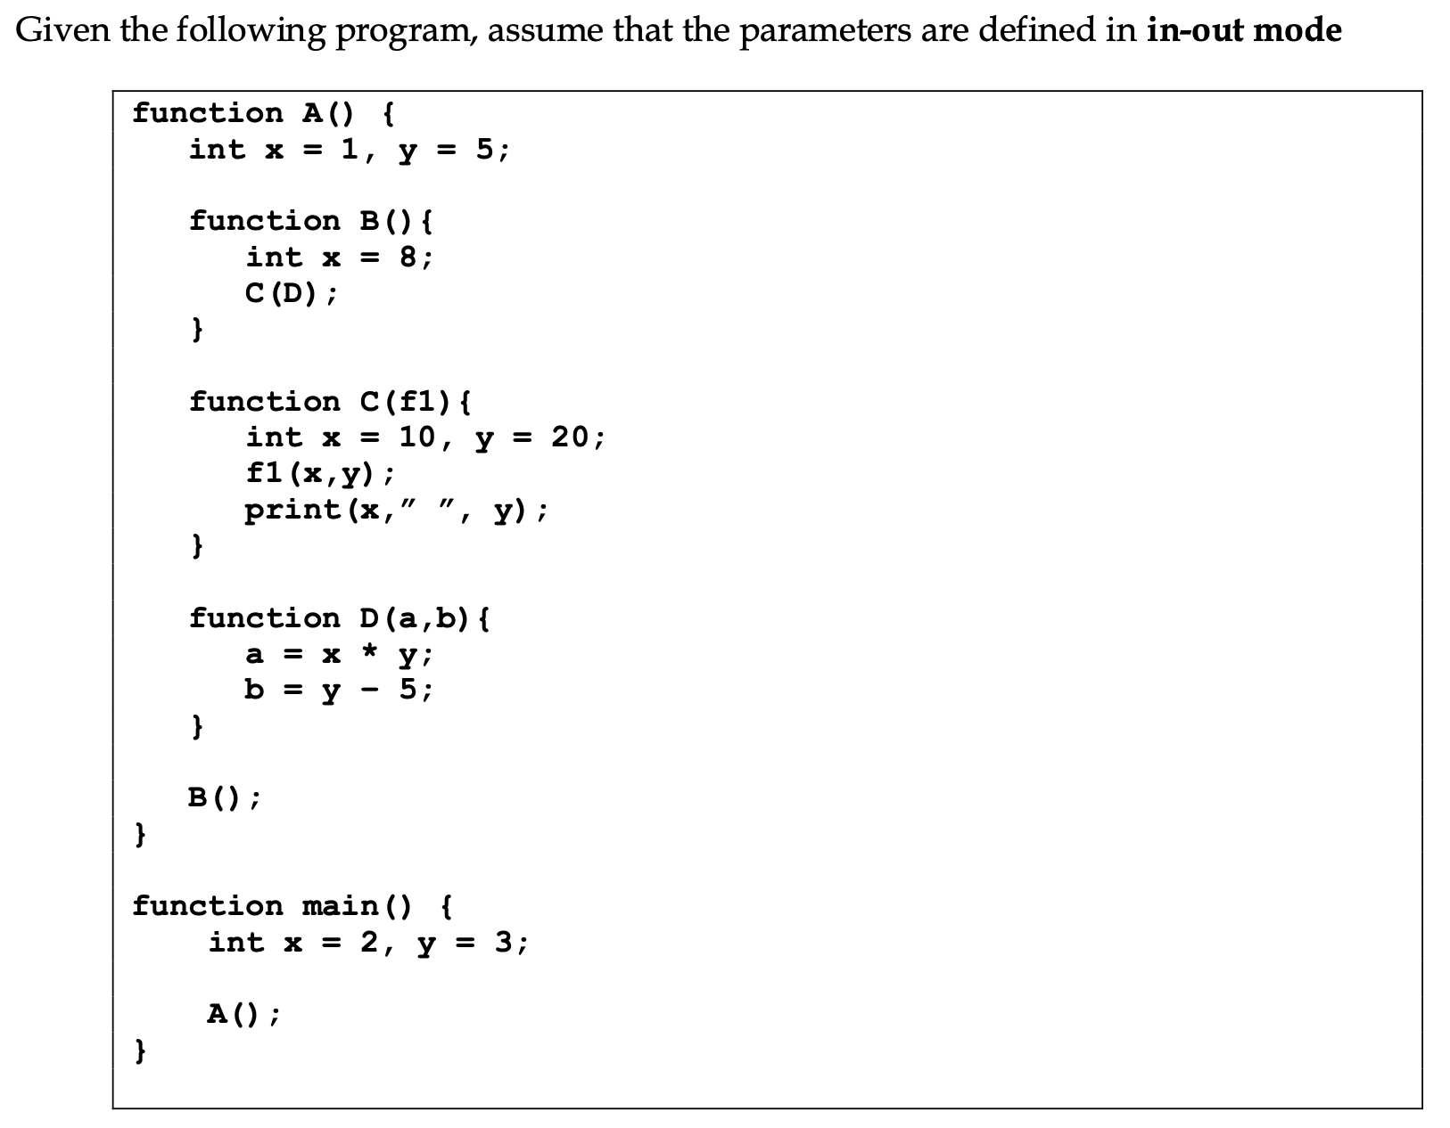
1- What will be the output if ad hoc binding is used, assuming that the language is statically scoped?
Hint: Ad hoc binding takes the referencing environment where the subprogram is passed.
So, x = 8, y = 5 initially
After calling D inside C, a = 40
b=0
output: 40 0

Slide 14
2- What will be the output if shallow binding is used, assuming language is dynamically scoped?
Hint: Shallow binding takes the referencing environment where the subprogram is called in.
So, x = 10, y = 20 initially
After calling D inside C, a = 200
b = 15
output: 200 15

Slide 15
3- What will be the output deep binding is used, assuming the language is statically scoped?
Hint: Deep binding takes the referencing environment where the subprogram is defined in.
So, x = 1, y = 5 initially
After calling D inside C, a= 5
b=0
output: 5 0

Slide 16
Given the following program, answer the questions below.
program MAIN
procedure BigSub
int b = 1, c = 3;
procedure sub1
int a = 7, d = 9;
procedure sub2
int e;
begin {sub2}
e = a + c ; ( * )
print(a, b, c, d, e);
end {sub2}
procedure sub3
int a = 4, c = 6;
procedure sub4
int b = 8, d = 10;
begin {sub4}
sub2;
end {sub4}
begin {sub3}
sub4;
end {sub3}
begin {sub1}
sub3;
end {sub1}
begin{BigSub}
sub1;
end{BigSub}
begin {MAIN}
BigSub;
end {MAIN}
Assuming that static scoping is used, what will be the output of the program?
7 1 3 9 10
Give the (chain_offset, local_offset) pairs at point * for the following variables
Assuming that dynamic scoping is used, what is the output of the program?
Note that the calling sequence is MAIN->BigSub->sub1->sub3->sub4->sub2
4 8 6 10 10
 | chain_offset | local_offset
a | 1 | 3 (4)
c | 2 | 4 (5)
e | 0 | 3 (4)

Slide 17
Given the following program, answer the questions below.
program MAIN
procedure BigSub
int b = 1, c = 3;
procedure sub1
int a = 7, d = 9;
procedure sub2
int e;
begin {sub2}
e = a + c ; ( * )
print(a, b, c, d, e);
end {sub2}
procedure sub3
int a = 4, c = 6;
procedure sub4
int b = 8, d = 10;
begin {sub4}
sub2;
end {sub4}
begin {sub3}
sub4;
end {sub3}
begin {sub1}
sub3;
end {sub1}
begin{BigSub}
sub1;
end{BigSub}
begin {MAIN}
BigSub;
end {MAIN}
Assume that dynamic scoping is implemented using the shallow-access method with a stack for each variable name. Show the contents of stacks (subprogram names) associated with the variable names {a,b,c,d} at the time of the execution of sub2 (when execution reaches to *).
Sub3 - 4 | Sub4 - 8 | Sub3 - 6 | Sub4 - 10
Sub1 - 7 | BigSub - 1 | BigSub - 3 | Sub1 - 9 | Sub2 (4+6=10)
a | b | c | d | e

